Slide 1
DARNELL KIKOO
Cross Health Insurance Prediction
F I N A L P R O JE C T

Slide 2
Table of Contents
1
2
3
Business Background
Data Understanding and Exploratory Data Analysis
Data Preprocessing
4
5
6
Modeling and Evaluation
Business Case Study
Conclusion and Reccomendation

Slide 3
Business Background

Slide 4
Background
I'm a freelance data scientist, recruited to work at one of the bigest insurance company in India
Our company wanted to increase the sales of vehicle insurance. Hence, I am asked to create a model to predict the possible reaction of policy holders if they are asked to buy one

Slide 5
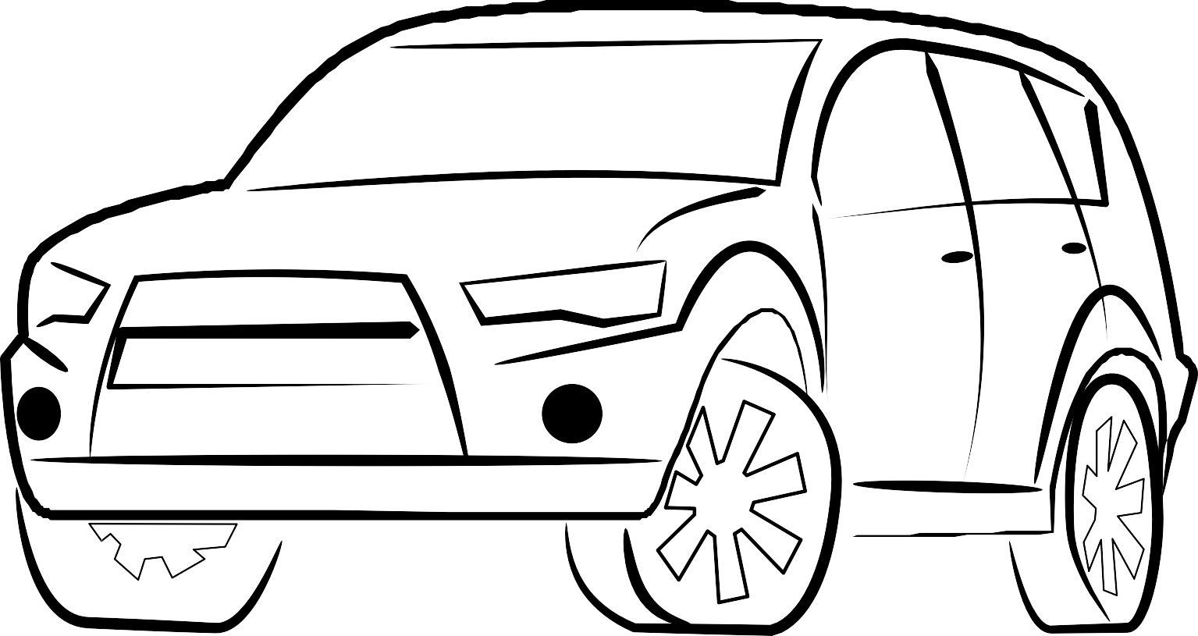
Business Objectives
The objective of this project is to predict whether a policy holder would be interested in insuring their vehicle. Helping the company to increase their sales and minimizing the range of customers that should be contacted for sales

Slide 6


Output
The output of this project is a model to predict the customer's response given its feature
The feature includes Vehicle_Damage, Previously_Insured, Gender, etc.

Slide 7
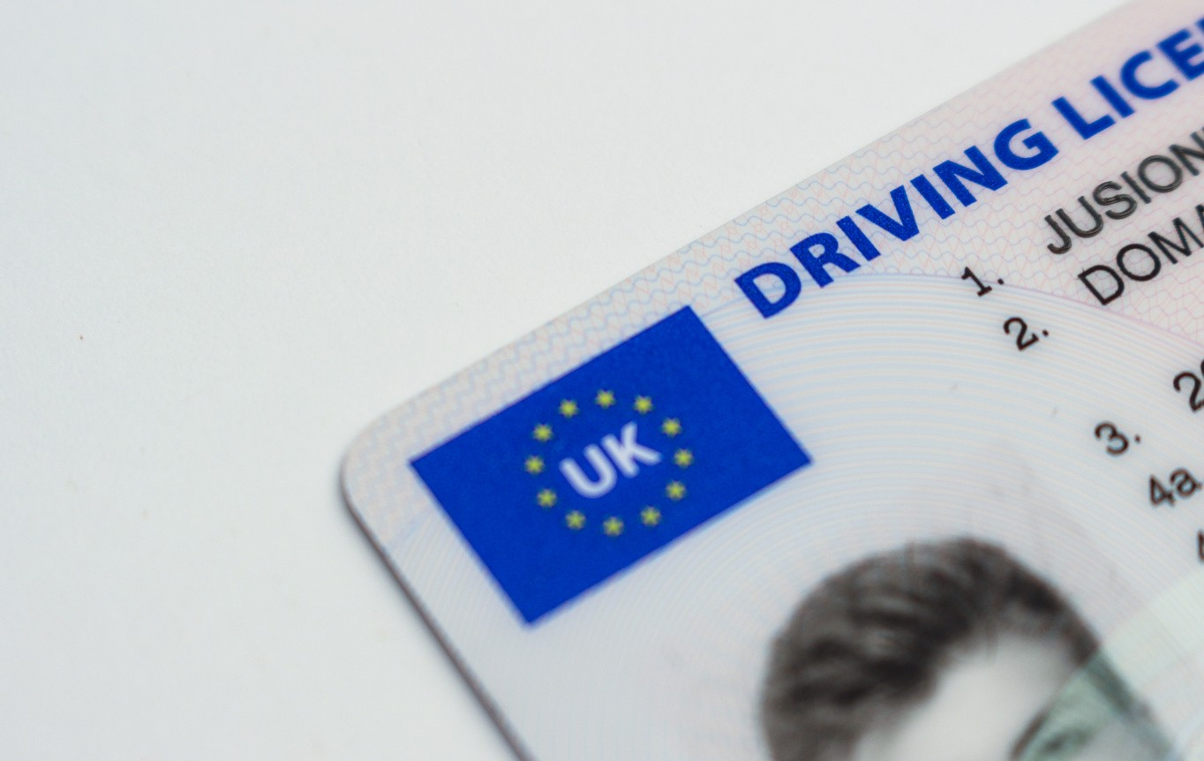

Project Limitation
We have limited knowledge towards some features, such as region_code and anonimyzed policy_sales_channel
We also decided to remove customer rows who doesn't have Driving_License

Slide 8

Analytic Approach
Machine Learning
Performance Measures
Supervised Learning (Binary Classification) Classify what response (label) the customer would
ROC_AUC
Precision, Recall, F1 and Accuracy to support our measurement
give

Slide 9
Data Understanding and Exploratory Data Analysis

Slide 10

Data Collection / Gathering
The dataset is provided by Kaggle, with 381109 Rows and 12 Columns

Slide 11
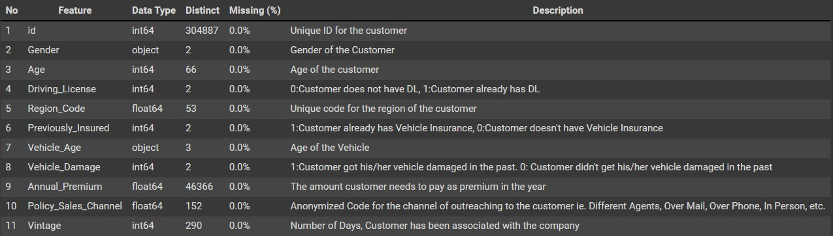
Column Explanation

Slide 12

Divided Dataset
We split the data into the ratio of 80:20, where the 80% is used for development, and the 20% is used for final prediction
80%
20%

Slide 13
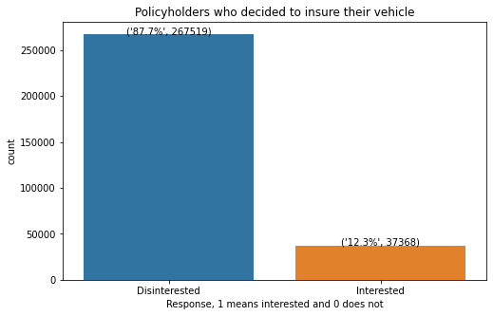
Response Distribution
The chart shows the distribution of the response, which majority appeared to be disinterested. This explains that 87%++ policyholders don't seem to be interested in insuring their vehicle

Slide 14
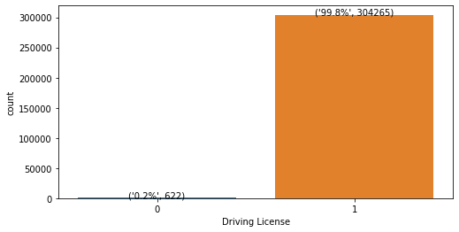
Driving License
The chart shows majority (99.8%) of policyholders do have driving license. In fact, it is rare to see someone who buys vehicle license but doesn't have a driving license. Hence, we assume that this is caused by mistyping and will remove the rows without driving license

Slide 15
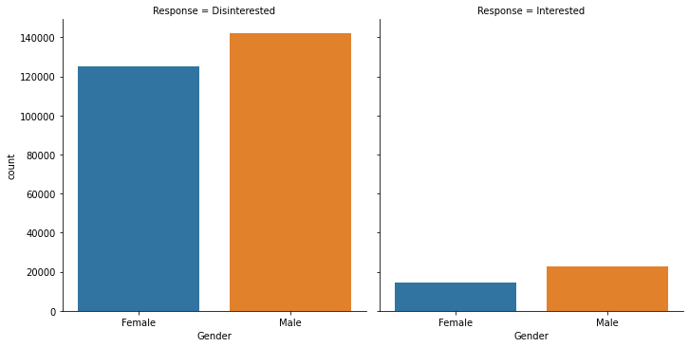
Gender on Response
Total male buy Insurance : 13.813196541395326% Total female buy Insurance : 10.421891187082485%
From the given dataset, males are more likely to buy vehicle insurance regardless of their age, with a bigger margin of 3.4% compared to Female.
We can say that male will give quite a big impact on the model

Slide 16
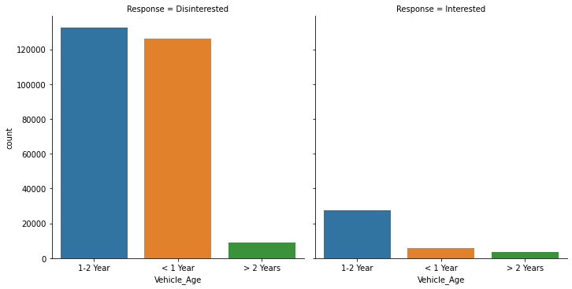
Vehicle Age on Response
Customer's Vehicle Age 1-2 Year and buy Insurance :
17.32 %
Customer's Vehicle Age Less Than 1 Year and buy Insurance :
4.42 %
Customer's Vehicle Age More Than 2 Years and buy Insurance:
29.63 %
Based on the vehicle age, there are more customers who have a vehicle aged between 0-2 years. However, customer whose car age is above 2 years have a bigger number of purchase on vehicle insurance

Slide 17
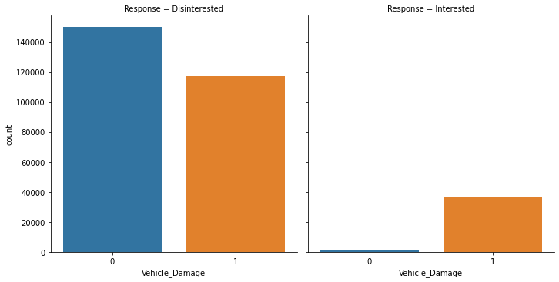
Vehicle Damage on Response
Customers who have ever had their vehicle damaged and buy Insurance: 23.74 % Customers who never had their vehicle damaged and buy Insurance : 0.52 %
Majority of policyholders who buys vehicle insurance, are those who have ever had their vehicle damaged. This might be affected by the psychological trauma caused by unwanted accidents and damage their vehicle

Slide 18
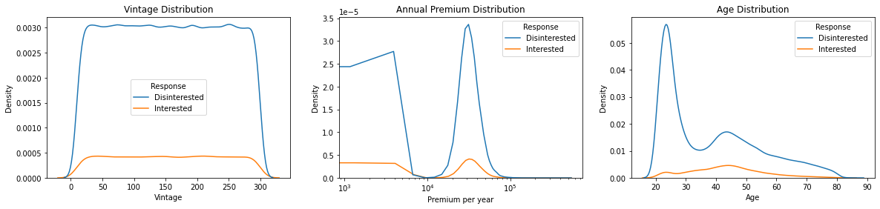
Numerical Column Distribution
While the first 2 charts doesn't have any strong information, the third chart tells us that majority of customers who buy vehicle insurance were from the 40-50 Age range

Slide 19
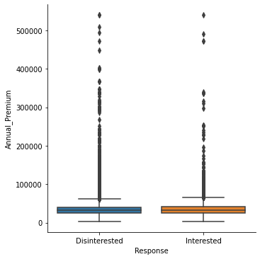
Customer's Annual Premium Distribution
The boxplot represents the outlier from the Annual_Premium feature.
Most policyholders in India buys insurance below Rs 60,000.
This shows the economic gap distribution between Indian citizens

Slide 20
Numerical Column Correlations
The heatmap doesn't show any strong correlation between features

Slide 21
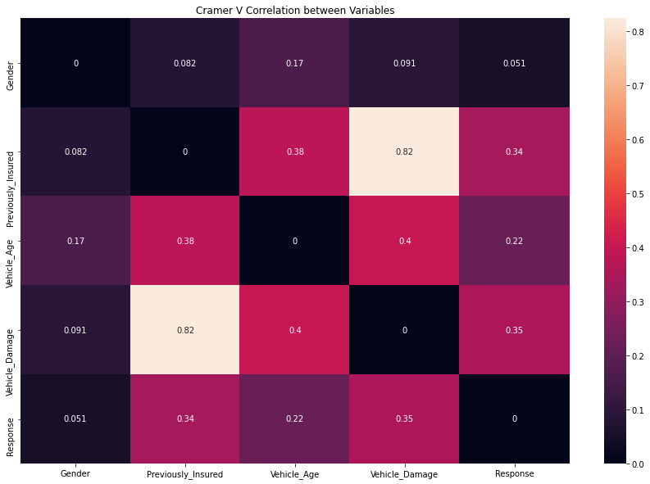
Categorical Column Correlations With Response Using Cramers V Heatmap
The Previously_Insured feature seems to have a strong relation with Vehicle_Damage
This is supported by the fact that people who have had their vehicle damaged will buy a vehicle insurance

Slide 22
Categorical Column Correlations With Response Using Cramers V Heatmap
Kruskal-Wallis Test results of Gender H Stat = 809.6826408737934
P = 4.2354192395808124e-178
Kruskal-Wallis Test results of Previously_Insured H Stat = 35440.63114163706
P = 0.0
Kruskal-Wallis Test results of Vehicle_Age H Stat = 14955.41399255504
P = 0.0
Kruskal-Wallis Test results of Vehicle_Damage H Stat = 38204.02112771305
P = 0.0
Using the statistical Kruskal-Wallis Test, we can safely assume that the categorical columns could help distinguish the Response, as all the P-Values are below 0.05

Slide 23
Data Preprocessing

Slide 24

1
2
3
Casting Data Types
Remove Unwanted Feature
Remove Rows with no Driving License, then remove the column
4
5
6
Encode Categorical Columns
Remove Outlier on Annual_Premium column
Normalized Numerical Columns

Slide 25
Casting Data Types
Casting any categorical columns types to category
Remove Unwanted Feature
The feature Policy_Sales_Channel and Region_Code are not relevant to real world applications.
Policy_Sales_Channel are anonymized saling code of the insurance company. Hence, we can't use it as we don't know what was the meaning of the values behind the feature. On the other hand, Region_Code represents 53++ distinct values, whereas the Government India stated only 35 state codes in India
Encode Categorical Columns

Slide 26
Remove Rows with no Driving License, then Remove the Column
The countplot shows that the number of people with no Driving License is really small, with a 6.2%. Hence, we decide to delete the row of customer without any Driving license, assuming that all of the customers who buy insurance vehicle must have a driving license.

Slide 27
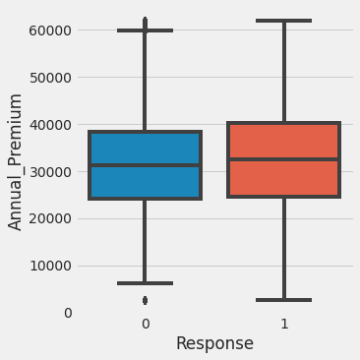
Remove Outlier on Annual_Premium column
We will remove the outliers using the Inter Quartile Range(IQR) method.

Slide 28
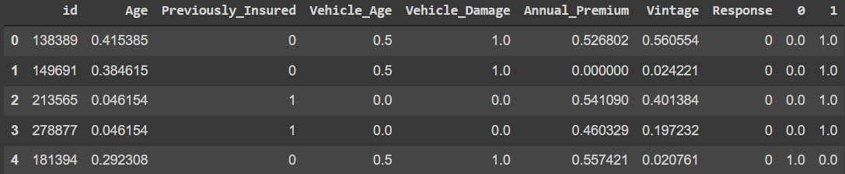
Normalized Numerical Columns
Normalizing numerical columns using MinMaxScaler, which has proven to improve our model by 23%

Slide 29
Modeling and Evaluation

Slide 30
Making Baseline Value
Making baseline value is important, so that we can use it as an measurement to improve and get our best model. In this case, we used LogisticRegression and DummyClassifier as our baseline model
Baseline Dummy Model ROC_AUC Score: 0.5
Baseline LogisticRegression Model without Normalization ROC-AUC Score: 0.6712248106072092
Baseline LogisticRegression After Normalization Model ROC-AUC Score: 0.8305344294005266

Slide 31
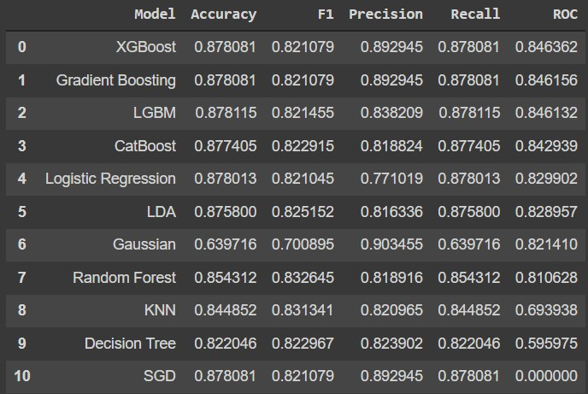
Split dataset and test over 10 models
From the testing, we got XGBoostClassifier as our best model based on the ROC. We choose it to get the best threshold value.
Hence, we will use it for further evaluation

Slide 32

Parameter tuning using GridSearchCV
What we do next is parameter tuning. In this case, we will use a library called GridSearchCV from ScikitLearn to help us in finding the best tuning parameters. Parameter tuning is used to improve our model and get better score than non-tuned model

Slide 33
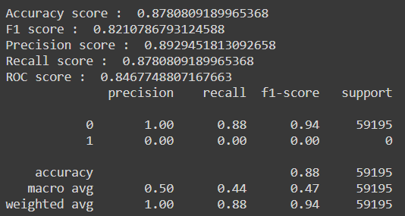
Evaluate the model
We then fit our model and test it with our test dataset. The precision and recall is still 0, it is because we still used the default threshold value, 0.5

Slide 34
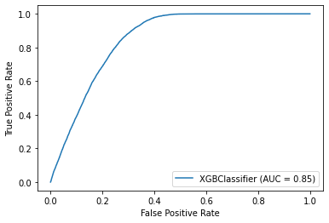
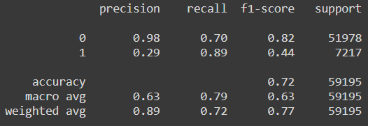
Changing Threshold Value
We then change our threshold according to the ROC_AUC score 0.85, and achieved a different yet better recall and precision! We will still be using this threshold value for further prediction with unseen dataset

Slide 35
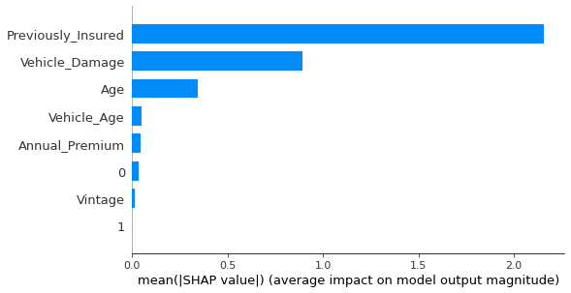
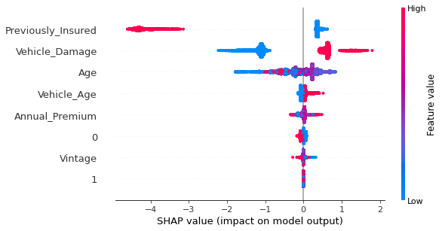
Feature Importance
Both SHAP value charts explained that Previously_Insured and Vehicle_Age was the most important feature, based on their feature importance

Slide 36
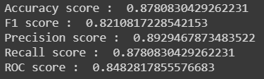
Prediction on Unseen Dataset
We then use the data than we have splitted for final prediction. The model has never seen this data yet.
Hence, it is perfect for evaluation
We still get a good score, despite our model facing unseen or new data

Slide 37
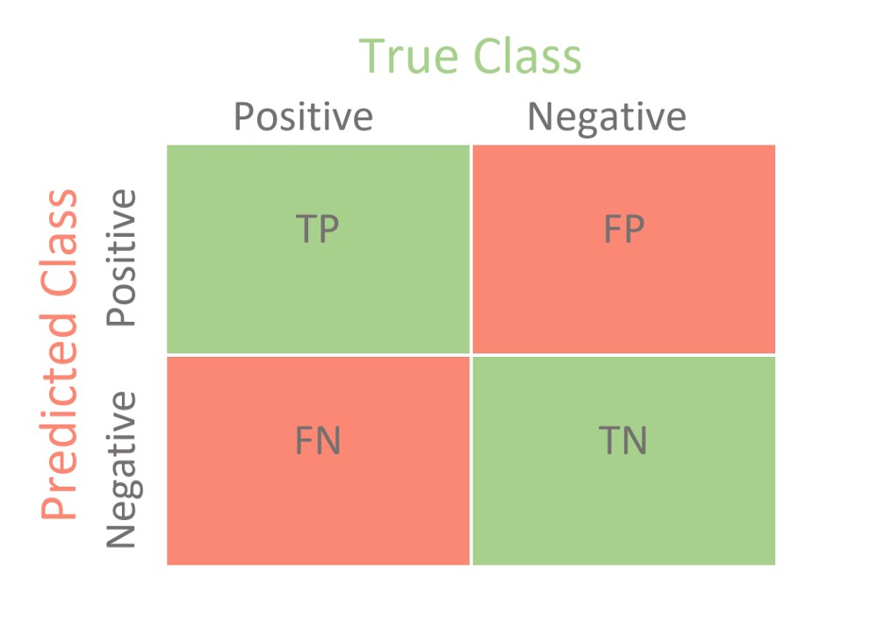
Using ROC_AUC as new threshold
We will still use our new threshold 0.85, to predict the new dataset. Then, we get the confusion matrix as below
If we want to target customers with any possibility to buy vehicle insurance, we can reduce the number of customers to be reached from 74034 to only 27476! This saves up to 62.9% in time and expenses
45511
19497
1047
7979

Slide 38

Model Improvement
Tuned XGBoost Model on Unseen Data
0.847
Using ROC_AUC score as the main metric, we managed to improve our metric score up to 69%!
69.4%
Baseline Dummy Model ROC_AUC Score
0.5
(Dummy Most_Frequent)

Slide 39
Business Case Study

Slide 40
Business Case Study
By Using Machine Learning, the insurance company can save up to 62.89% in saling expenses(Reaching out customer, operation expenses, etc.
The insurance company can also save up time from contacting every single policyholders, assuming that they use the model prediction output to reach out customers

Slide 41
Conclusion and Reccomendation

Slide 42
Conclusion
Supervised Machine Learning has been proven to be able to predict the customer's response with 0.85 roc_auc score and 0.89 recall score
It also helps the company to reduce expenses up to 63% from reaching out customers and sales
Reccomendation
Get a deeper domain knowledge regarding previous column that got dropped, which can be used to improve the model
Add more rows and features to the model, so to reduce underfitting and improve model variation
Focus to look reach out policyholders who have ever had their vehicle damaged

Slide 43

Contact Us
E M A I L A D D R E SS
darnellkikoo@gmail.com
PH O N E N U M BE R
+6281218222211
CU R R E N T PR O JE CT GI T H U B L I N K :
https://github.com/darnellkikoo/AlgoBC_FProject

Slide 44
H

